Slide 1
Lecture 2
Divide-and-conquer, MergeSort, and Big-O notation

Slide 2
Announcements
Sign up for Piazza!
Connect with course staff!
Connect with your colleagues!
Form study groups!
Receive course announcements!
Please (continue to) send OAE requests and exam conflicts to cs161-win1819-staff@lists.stanford.edu

Slide 3
More Announcements
Homework!
HW1 will be released Friday.
It is due the following Friday.
See the website for guidelines on homework:
Collaboration policy
Best practices
Example Homework!!!!
LaTeX help.

Slide 4
How to download IPython notebooks
Right-click and “Save link as” (or equivalent):

Slide 5
Office Hours and Sections
We are still working on scheduling these!
We will post an announcement on Piazza soon when the schedule is finalized.
Don’t worry, there will be plenty of office hours!
You don’t need to formally enroll in sections.

Slide 6
Piazza Heroes
Thanks for helping out your colleagues!
Top Piazza Answerers:

Slide 7
Bonus slide on Karatsuba
I realized based on the questions after class on Monday that I was unclear about how the Karatsuba recursion worked – sorry!
I added a bonus slide with more details, you can take a look at that or at the python code.
If you are still confused, ask on Piazza or OH!

Slide 8
Thanks for the anonymous feedback!
Keep it coming!
Where are the videos?
On canvas (link from website), or mvideox (link from website)
But! SCPD warns that it will be moving exclusively to Canvas and suggests you use Canvas.
“I’m worried that I’ll slow the class down if I ask questions.”
Don’t worry! It’s my job to keep the class on pace, it’s your job to let me know if you are confused.
(I know it can be intimidating…but please know that I really value your questions!)

Slide 9
End of announcements!

Slide 10
Last time
Cast
Philosophy
Algorithms are awesome!
Our motivating questions:
Does it work?
Is it fast?
Can I do better?
Plucky the pedantic penguin
Lucky the lackadaisical lemur
Think-Pair-Share Terrapins
Technical content
Karatsuba integer multiplication
Example of “Divide and Conquer”
Not-so-rigorous analysis
Ollie the
over-achieving ostrich
Siggi the
studious stork

Slide 11
Today
We are going to ask:
Does it work?
Is it fast?
We’ll start to see how to answer these by looking at some examples of sorting algorithms.
InsertionSort
MergeSort
SortingHatSort not discussed

Slide 12
The plan
Part I: Sorting Algorithms
InsertionSort: does it work and is it fast?
MergeSort: does it work and is it fast?
Skills:
Analyzing correctness of iterative and recursive algorithms.
Analyzing running time of recursive algorithms (part 1…more next time!)
Part II: How do we measure the runtime of an algorithm?
Worst-case analysis
Asymptotic Analysis

Slide 13
Sorting
Important primitive
For today, we’ll pretend all elements are distinct.
6
4
3
8
1
5
2
7
1
2
3
4
5
6
7
8

Slide 14
I hope everyone did the pre-lecture exercise!
def mysteryAlgorithmOne(A):
for x in A:
B = [None for i in range(len(A))]
for i in range(len(B)):
if B[i] == None or B[i] > x:
j = len(B)-1
while j > i:
B[j] = B[j-1]
j -= 1
B[i] = x
break
return B
What was the mystery sort algorithm?
MergeSort
QuickSort
InsertionSort
BogoSort
def MysteryAlgorithmTwo(A):
for i in range(1,len(A)):
current = A[i]
j = i-1
while j >= 0 and A[j] > current:
A[j+1] = A[j]
j -= 1
A[j+1] = current

Slide 15
I hope everyone did the pre-lecture exercise!
def mysteryAlgorithmOne(A):
for x in A:
B = [None for i in range(len(A))]
for i in range(len(B)):
if B[i] == None or B[i] > x:
j = len(B)-1
while j > i:
B[j] = B[j-1]
j -= 1
B[i] = x
break
return B
What was the mystery sort algorithm?
MergeSort
QuickSort
InsertionSort
BogoSort
def MysteryAlgorithmTwo(A):
for i in range(1,len(A)):
current = A[i]
j = i-1
while j >= 0 and A[j] > current:
A[j+1] = A[j]
j -= 1
A[j+1] = current

Slide 16
InsertionSort example
6
4
3
8
5
Start by moving A[1] toward the beginning of the list until you find something smaller (or can’t go any further):
Then move A[3]:
6
4
3
8
5
3
4
6
8
5
4
6
3
8
5
3
4
6
8
5
Then move A[2]:
Then move A[4]:
4
6
3
8
5
3
4
6
8
5
3
4
6
8
5
3
4
5
6
8
Then we are done!

Slide 17
Insertion Sort
Does it work?
Is it fast?

Slide 18
Insertion Sort
Does it work?
Is it fast?
The “same” algorithm can be faster or slower depending on the implementation…
We are interested in how fast the running time scales with n, the size of the input.

Slide 19
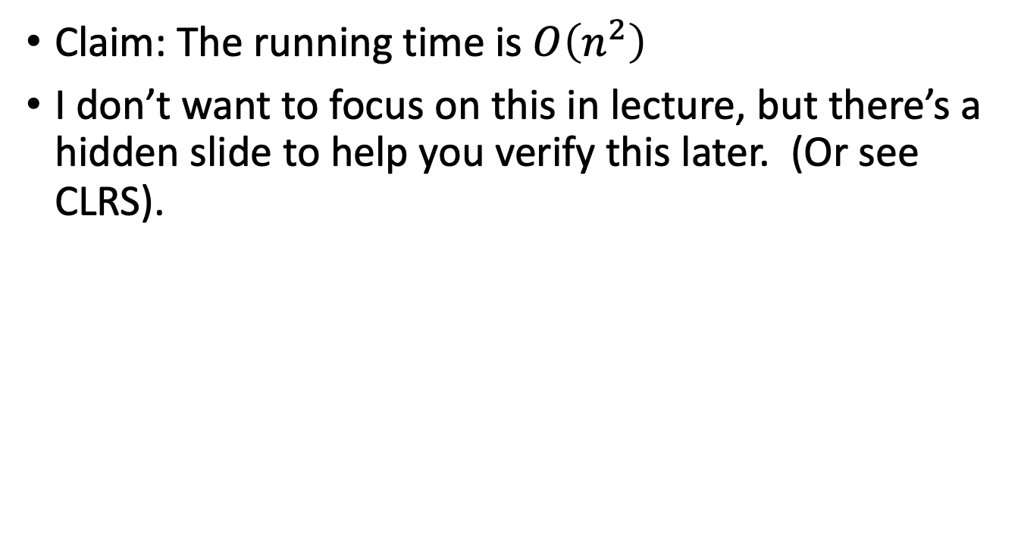
Insertion Sort: running time
Technically we haven’t defined this yet…we’ll do it later in this lecture.
Claim: The running time is $O\left(n^{2}\right)$
I don’t want to focus on this in lecture, but there’s a hidden slide to help you verify this later. (Or see CLRS).
Verify this!
Seems plausible

Slide 20
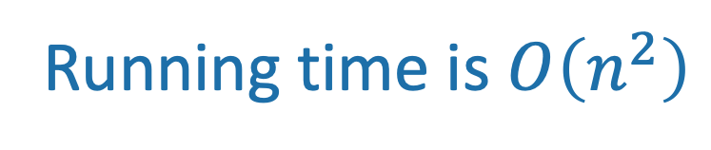
Insertion Sort: running time
SLIDE SKIPPED IN CLASS
def InsertionSort(A):
for i in range(1,len(A)):
current = A[i]
j = i-1
while j >= 0 and A[j] > current:
A[j+1] = A[j]
j -= 1
A[j+1] = current
n-1 iterations of the outer loop
In the worst case, about n iterations of this inner loop
Running time is $O\left(n^{2}\right)$

Slide 21
Insertion Sort
Does it work?
Is it fast?
Okay, so it’s pretty obvious that it works.
HOWEVER! In the future it won’t be so obvious, so let’s take some time now to see how we would prove this rigorously.

Slide 22
Why does this work?
Say you have a sorted list, , and another element .
Insert right after the largest thing that’s still smaller than . (Aka, right after ).
Then you get a sorted list:
3
4
6
8
5
5
5
4
3
4
5
6
8

Slide 23
So just use this logic at every step.
6
4
3
8
5
4
3
8
5
The first element, [6], makes up a sorted list.
4
6
3
8
5
So correctly inserting 4 into the list [6] means that [4,6] becomes a sorted list.
4
6
3
8
5
The first two elements, [4,6], make up a sorted list.
3
4
6
8
5
So correctly inserting 3 into the list [4,6] means that [3,4,6] becomes a sorted list.
3
4
6
8
5
The first three elements, [3,4,6], make up a sorted list.
3
4
6
8
5
So correctly inserting 8 into the list [3,4,6] means that [3,4,6,8] becomes a sorted list.
3
4
6
8
5
The first four elements, [3,4,6,8], make up a sorted list.
3
4
5
6
8
So correctly inserting 5 into the list [3,4,6,8] means that [3,4,5,6,8] becomes a sorted list.
YAY WE ARE DONE!

Slide 24
This sounds like a job for…
Proof By
Induction!

Slide 25
Recall: proof by induction
This slide skipped in class; for reference only.
A loop invariant is something that should be true at every iteration.
Maintain a loop invariant.
Proceed by induction.
Four steps in the proof by induction:
Inductive Hypothesis: The loop invariant holds after the i^{th} iteration.
Base case: the loop invariant holds before the 1st iteration.
Inductive step: If the loop invariant holds after the i^{th} iteration, then it holds after the (i+1)^{st} iteration
Conclusion: If the loop invariant holds after the last iteration, then we win.

Slide 26
Formally: induction
A “loop invariant” is something that we maintain at every iteration of the algorithm.
Loop invariant(i): A[:i+1] is sorted.
Inductive Hypothesis:
The loop invariant(i) holds at the end of the i^{th} iteration (of the outer loop).
Base case (i=0):
Before the algorithm starts, A[:1] is sorted. ✓
Inductive step:
If the inductive hypothesis holds at step i, it holds at step i+1
Aka, if A[:i+1] is sorted at step i, then A[:i+2] is sorted at step i+1
Conclusion:
At the end of the n-1’st iteration (aka, at the end of the algorithm), A[:n] = A is sorted.
That’s what we wanted! ✓
This logic (see handout for details)
4
6
3
8
5
The first two elements, [4,6], make up a sorted list.
3
4
6
8
5
So correctly inserting 3 into the list [4,6] means that [3,4,6] becomes a sorted list.
This was iteration i=2.

Slide 27
There is a handout with the details!
See website!

Slide 28
Aside: proofs by induction
We’re gonna see/do/skip over a lot of them.
I’m assuming you’re comfortable with them from CS103.
When you assume…
If that went by too fast and was confusing:
Slides [there’s a hidden one with more info about induction]
Re-watch the lecture video
Handout
Book
Office Hours
Make sure you really understand the argument on the previous slide! Check out the handout for a formal write-up.
Siggi the Studious Stork

Slide 29
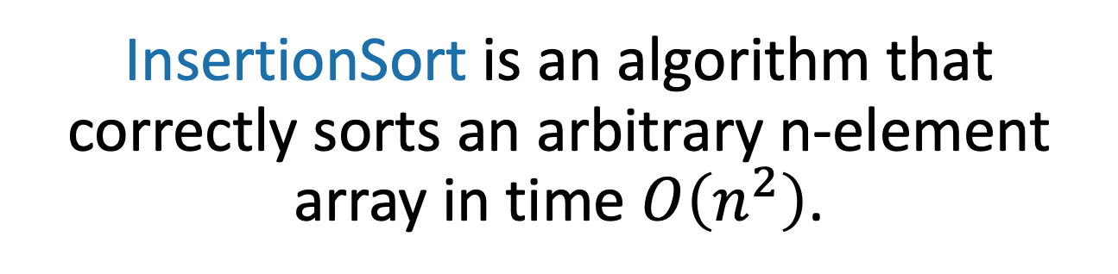
What have we learned?
InsertionSort is an algorithm that correctly sorts an arbitrary n-element array in time $O\left(n^{2}\right)$.
Can we do better?

Slide 30
The plan
Part I: Sorting Algorithms
InsertionSort: does it work and is it fast?
MergeSort: does it work and is it fast?
Skills:
Analyzing correctness of iterative and recursive algorithms.
Analyzing running time of recursive algorithms (part A)
Part II: How do we measure the runtime of an algorithm?
Worst-case analysis
Asymptotic Analysis

Slide 31
Can we do better?
MergeSort: a divide-and-conquer approach
Recall from last time:
Divide and Conquer:
Big problem
Smaller problem
Smaller problem
Recurse!
Recurse!
Yet smaller problem
Yet smaller problem
Yet smaller problem
Yet smaller problem

Slide 32
MergeSort
6
4
3
8
1
5
2
7
6
4
3
8
1
5
2
7
Recursive magic!
Recursive magic!
3
4
6
8
1
2
5
7
How would you do this in-place?
MERGE!
1
2
3
4
5
6
7
8
Code for the MERGE step is given in the Lecture2 IPython notebook, or CRLS
Ollie the over-achieving Ostrich

Slide 33
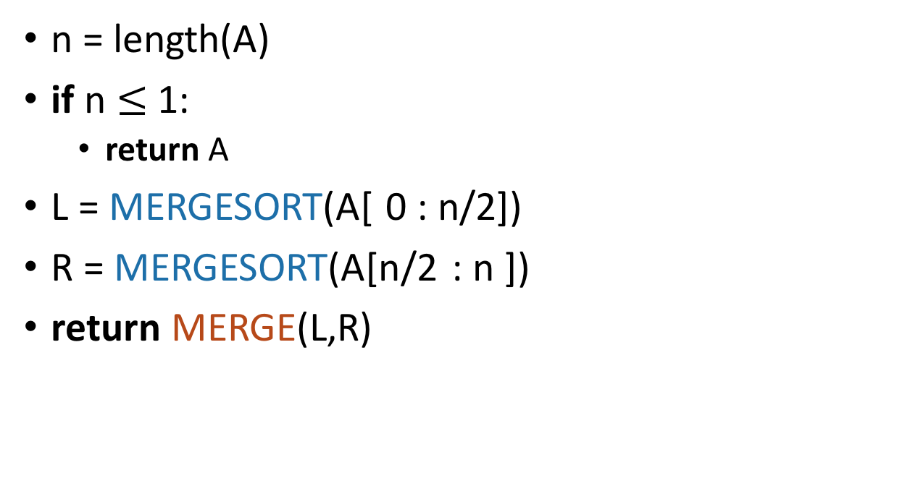
MergeSort Pseudocode
See Lecture 2 IPython notebook for MergeSort Python Code.
MERGESORT(A):
n = length(A)
if n $≤$ 1:
return A
L = MERGESORT(A[ 0 : n/2])
R = MERGESORT(A[n/2 : n ])
return MERGE(L,R)
If A has length 1,
It is already sorted!
Sort the left half
Sort the right half
Merge the two halves
Notes:
Okay, this pseudo-code is actually pretty intuitive, it's follows our english description.
(Question to ponder: what if we wanted to do this in-place?)

Slide 34
What actually happens? First, recursively break up the array all the way down to the base cases
6
4
3
8
1
5
2
7
6
4
3
8
1
5
2
7
6
4
3
8
1
5
2
7
6
4
3
8
1
5
2
7
This array of length 1 is sorted!

Slide 35
Then, merge them all back up!
Sorted sequence!
1
2
3
4
5
6
7
8
Merge!
3
4
6
8
1
2
5
7
Merge!
Merge!
4
6
3
8
1
5
2
7
Merge!
Merge!
Merge!
Merge!
6
4
3
8
1
5
2
7
A bunch of sorted lists of length 1 (in the order of the original sequence).
Notes:
Here's a different way of looking at merge sort. Let's take the same example, and think about it in terms of what order the MERGE calls happen in (instead of what order the recursive calls happen in)

Slide 36
Two questions
Does this work?
Is it fast?
IPython notebook says…
Empirically:
Seems to work.
Seems fast.

Slide 37
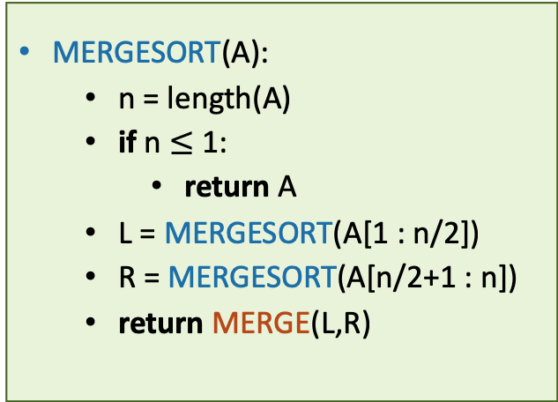
It works
Assume that n is a power of 2 for convenience.
Inductive hypothesis:
“In every the recursive call on an array of length at most i, MERGESORT returns a sorted array.”
Base case (i=1): a 1-element array is always sorted.
Inductive step: Need to show: If L and R are sorted, then MERGE(L,R) is sorted.
Conclusion: In the top recursive call, MERGESORT returns a sorted array.
MERGESORT(A):
n = length(A)
if n $≤$ 1:
return A
L = MERGESORT(A[1 : n/2])
R = MERGESORT(A[n/2+1 : n])
return MERGE(L,R)
Fill in the inductive step! (Either do it yourself or read it in CLRS Section 2.3.1!)

Slide 38
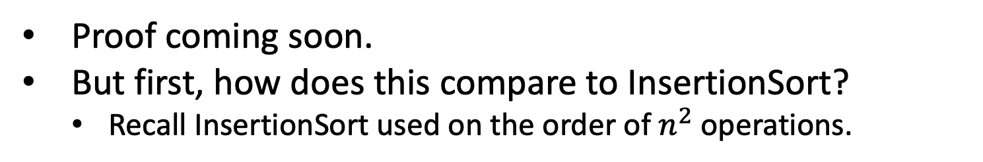
It’s fast
Assume that n is a power of 2 for convenience.
CLAIM:
MergeSort requires at most 11n (log(n) + 1) operations to sort n numbers.
Proof coming soon.
But first, how does this compare to InsertionSort?
Recall InsertionSort used on the order of $n^{2}$ operations.
What exactly is an “operation” here? We’re leaving that vague on purpose. Also the number 11 is sort of made-up.

Slide 39
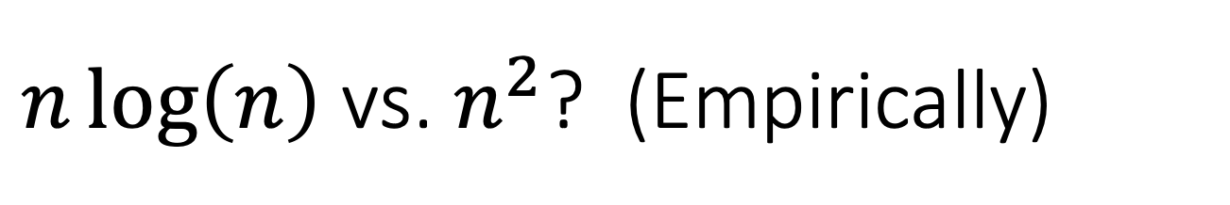
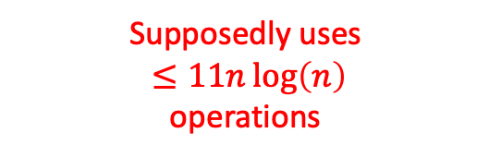
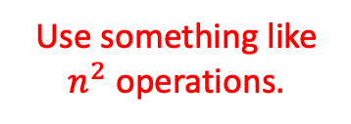
$n\log\left(n\right)$ vs. $n^{2}$? (Empirically)
[See Lecture 2 IPython Notebook for code]
Use something like $n^{2}$ operations.
Supposedly uses
$≤11n\log\left(n\right)$
operations

Slide 40
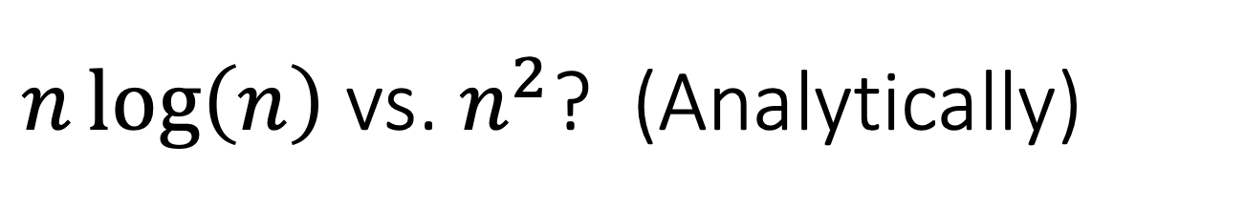
$n\log\left(n\right)$ vs. $n^{2}$? (Analytically)

Slide 41

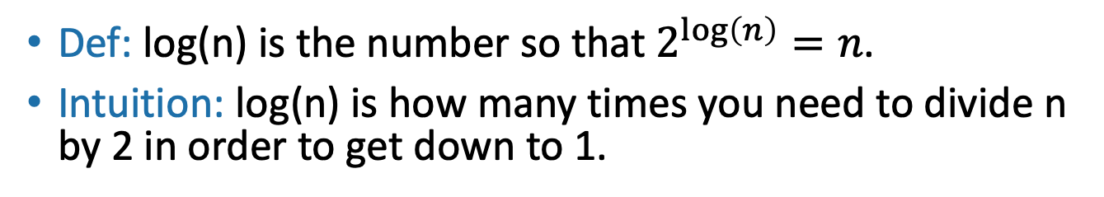

Quick log refresher
All logarithms in this course are base 2
Aside:
Def: log(n) is the number so that $2^{\log\left(n\right)}=n$.
Intuition: log(n) is how many times you need to divide n by 2 in order to get down to 1.
32, 16, 8, 4, 2, 1
log(32) = 5
$$⇒$$
Halve 5 times
$$⇒$$
log(64) = 6
64, 32, 16, 8, 4, 2, 1
log(128) = 7
log(256) = 8
log(512) = 9
….
log(# particles in the universe) < 280
Halve 6 times
log(n) grows very slowly!

Slide 42
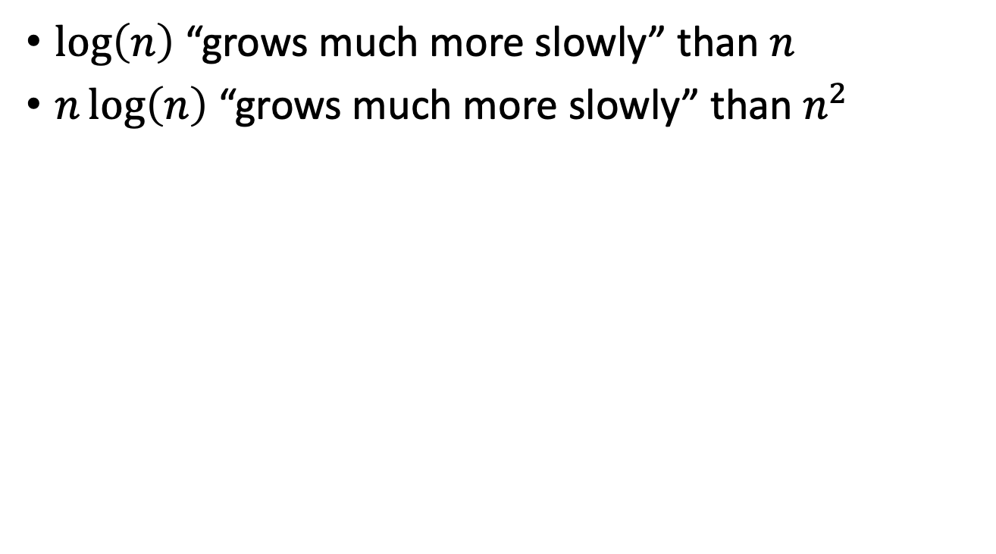
$n\log\left(n\right)$ vs. $n^{2}$? (Analytically)
$\log\left(n\right)$ “grows much more slowly” than $n$
$n\log\left(n\right)$ “grows much more slowly” than $n^{2}$
We will be more precise about this in part II of the lecture!

Slide 43
Now let’s prove the claim
Assume that n is a power of 2 for convenience.
CLAIM:
MergeSort requires at most 11n (log(n) + 1) operations to sort n numbers.

Slide 44
Let’s prove the claim
Size n
Level 0
n/2
n/2
Level 1
n/4
n/4
n/4
n/4
…
Focus on just one of these sub-problems
Level t
n/2^{t}
n/2^{t}
n/2^{t}
n/2^{t}
n/2^{t}
n/2^{t}
…
(Size 1)

Slide 45
How much work in this sub-problem?
n/2^{t}
Time spent MERGE-ing the two subproblems
+
n/2^{t+1}
n/2^{t+1}
Time spent within the two sub-problems

Slide 46
How much work in this sub-problem?
Let k=n/2^{t}…
k
Time spent MERGE-ing the two subproblems
+
k/2
k/2
Time spent within the two sub-problems

Slide 47
How long does it take to MERGE?
k
Code for the MERGE step is given in the Lecture2 notebook.
k/2
k/2
k/2
k/2
3
4
6
8
1
2
5
7
MERGE!
1
2
3
4
5
6
7
8
k

Slide 48
How long does it take to MERGE?
k
Code for the MERGE step is given in the Lecture2 notebook.
k/2
k/2
About how many operations does it take to run MERGE on two lists of size k/2?
Think-Pair-Share Terrapins

Slide 49
Operations within a subproblem of size k
THIS SLIDE SKIPPED IN CLASS. It’s here just in case you are curious how Lucky got “11”. (But, we will see later why the number 11 doesn’t really matter!)
The moral of the story is that you don’t need to pay attention to this slide!
Get the length of A (one op)
Compare that length to 1 (one op)
Initialize an array of size k (k ops)
Pass L and R into MergeSort
If we implement this intelligently, this means assigning two pointers.
Assign two initial pointers, one to each list.
For k iterations:
Assign one pointer in the list you are writing into.
Write one value in the list you are writing into.
Increment two pointers
So this is $1+1+k+2+2+k\left(1+1+2\right)=5k+6≤11k$ as long as $k≥1.$

Slide 50
How long does it take to MERGE?
k
Code for the MERGE step is given in the Lecture2 notebook.
k/2
k/2
Time to initialize an array of size k
Plus the time to initialize three counters
Plus the time to increment two of those counters k/2 times each
Plus the time to compare two values at least k times
Plus the time to copy k values from the existing array to the big array.
Plus…
Let’s say no more than 11k operations.
There’s a hidden slide which sort of explains this number “11,” but it’s a bit silly and we’ll see in a little by why it doesn’t matter.
Plucky the Pedantic Penguin
Lucky the lackadaisical lemur

Slide 51
Recursion tree
Size n
n/2
n/2
n/4
n/4
n/4
n/4
…
n/2^{t}
n/2^{t}
n/2^{t}
n/2^{t}
n/2^{t}
n/2^{t}
There are 11k operations done at this node.
…
k
(Size 1)
k/2
k/2

Slide 52
Recursion tree
Think, Pair, Share!
Size n
How many operations are done at this level of the tree? (Just MERGE-ing subproblems).
n/2
n/2
How about at this level of the tree?
(between both n/2-sized problems)
n/4
n/4
n/4
n/4
This level?
…
This level?
n/2^{t}
n/2^{t}
n/2^{t}
n/2^{t}
n/2^{t}
n/2^{t}
There are 11k operations done at this node.
…
k
(Size 1)
k/2
k/2

Slide 53
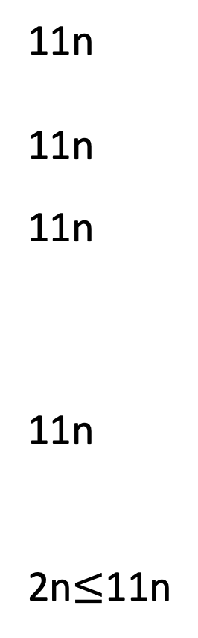
Recursion tree
Size of each
problem
#
problems
Amount of work at this level
Level
Size n
0
1
2
4
2^{t}
n
n
n/2
n/4
n/2^{t}
1
11n
11n
11n
11n
2n$≤$11n
n/2
n/2
1
n/4
n/4
n/4
n/4
2
…
…
Explanation for this table done on the board!
n/2^{t}
n/2^{t}
n/2^{t}
n/2^{t}
n/2^{t}
n/2^{t}
t
…
…
Note: At the lowest level we only have two operations per problem, to get the length of the array and compare it to 1.
log(n)
(Size 1)

Slide 54
Total runtime…
11n steps per level, at every level
log(n) + 1 levels
11n (log(n) + 1) steps total
That was the claim!

Slide 55
What have we learned?
MergeSort correctly sorts a list of n integers in at most 11n(log(n) + 1) operations.

Slide 56
A few reasons to be grumpy
Sorting
should take zero steps…
What’s with this 11k bound?
You (Mary/Lucky) made that number “11” up.
Different operations don’t take the same amount of time.
1
2
3
4
5
6
7
8

Slide 57
How we will deal with grumpiness
Take a deep breath…
Worst case analysis
Asymptotic notation

Slide 58
The plan
Part I: Sorting Algorithms
InsertionSort: does it work and is it fast?
MergeSort: does it work and is it fast?
Skills:
Analyzing correctness of iterative and recursive algorithms.
Analyzing running time of recursive algorithms (part A)
Part II: How do we measure the runtime of an algorithm?
Worst-case analysis
Asymptotic Analysis

Slide 59
Worst-case analysis
Sorting a sorted list should be fast!!
The “running time” for an algorithm is its running time on the worst possible input.
Pros: very strong guarantee
Cons: very strong guarantee
Here is my algorithm!
Algorithm:
Do the thing
Do the stuff
Return the answer
Here is an input!
(Which I designed to be terrible for your algorithm!)
Algorithm designer

Slide 60
Big-O notation
How long does an operation take? Why are we being so sloppy about that “11”?
What do we mean when we measure runtime?
We probably care about wall time: how long does it take to solve the problem, in seconds or minutes or hours?
This is heavily dependent on the programming language, architecture, etc.
These things are very important, but are not the point of this class.
We want a way to talk about the running time of an algorithm, independent of these considerations.

Slide 61
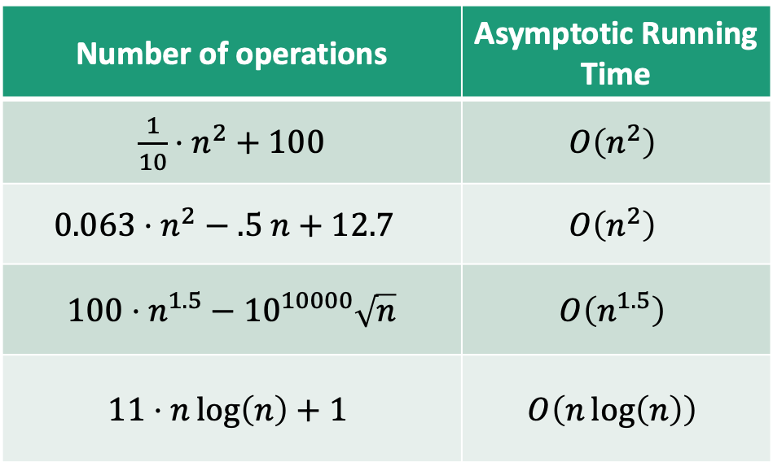
Main idea:
Focus on how the runtime scales with n (the input size).
Informally….
(Only pay attention to the largest function of n that appears.)
Number of operations | Asymptotic Running Time
$\frac{1}{10}⋅n^{2}+100$ | $$O\left(n^{2}\right)$$
$$0.063⋅n^{2}−.5 n+12.7$$ | $$O\left(n^{2}\right)$$
$100⋅n^{1.5}−{10}^{10000}\sqrt{n}$ | $$O\left(n^{1.5}\right)$$
$$11⋅n\log\left(n\right)+1$$ | $$O\left(n\log\left(n\right)\right)$$
We say this algorithm is “asymptotically faster” than the others.

Slide 62
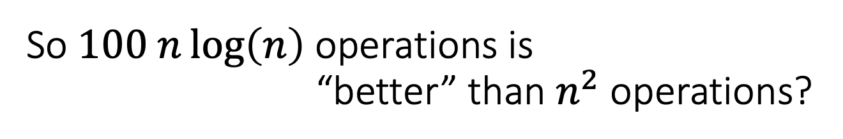
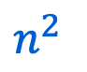
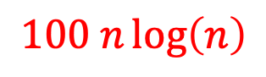
So $100 n\log\left(n\right)$ operations is “better” than $n^{2}$ operations?
$n^{2}$
$$100 n\log\left(n\right)$$
Yeah, but it’s true once n is at least 700 or so.
But when n=200, that’s not true at all!

Slide 63
Asymptotic Analysis
One algorithm is “faster” than another if its runtime scales better with the size of the input.
Pros:
Cons:
Abstracts away from hardware- and language-specific issues.
Makes algorithm analysis much more tractable.
Only makes sense if n is large (compared to the constant factors).
1000000000 n
is “better” than n² ?!?!
Without making Plucky grumpy!

Slide 64
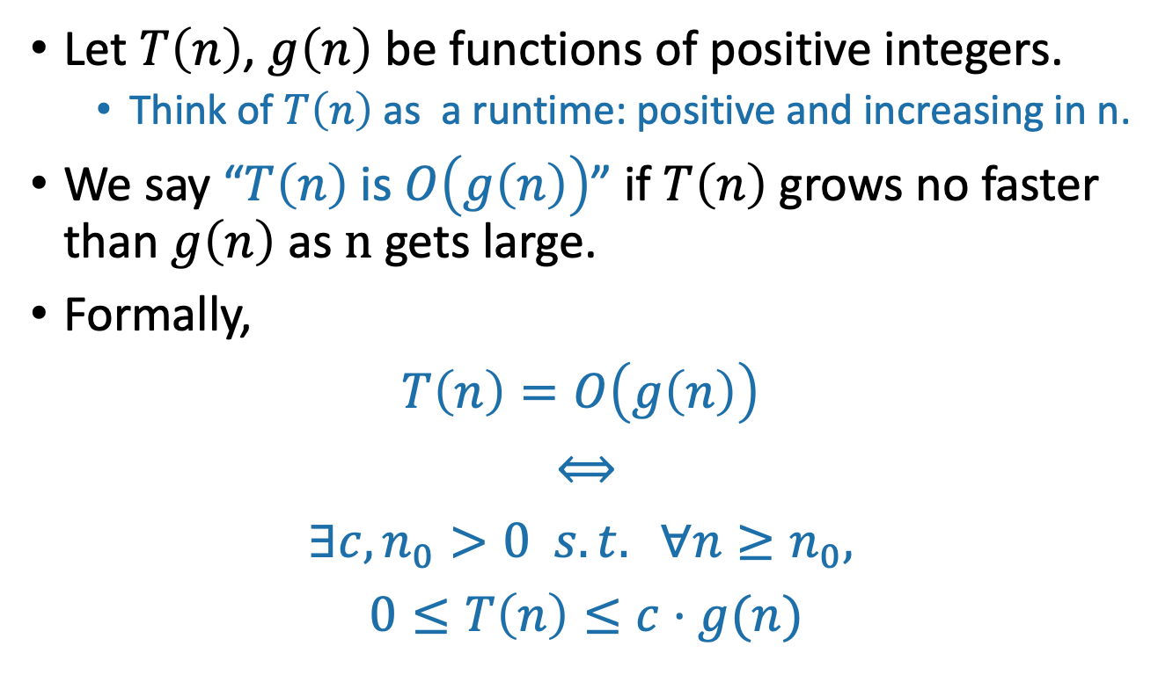
O(…) means an upper bound
pronounced “big-oh of …” or sometimes “oh of …”
Let $T\left(n\right)$, $g\left(n\right)$ be functions of positive integers.
Think of $T\left(n\right)$ as a runtime: positive and increasing in n.
We say “$T\left(n\right)$ is $O\left(g\left(n\right)\right)$” if $T\left(n\right)$ grows no faster than $g\left(n\right)$ as n gets large.
Formally,
$$T\left(n\right)=O\left(g\left(n\right)\right)$$
$$⟺$$
$$∃c, n_{0}>0 s.t. ∀n≥n_{0},$$
$$0≤T\left(n\right)≤c⋅g(n)$$

Slide 65
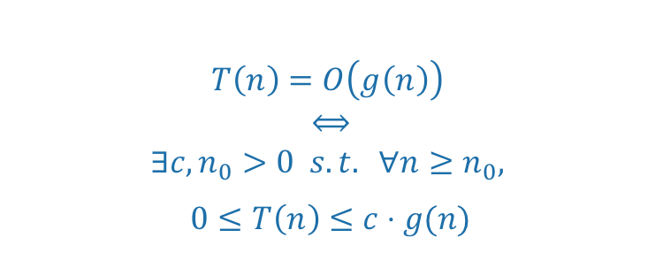
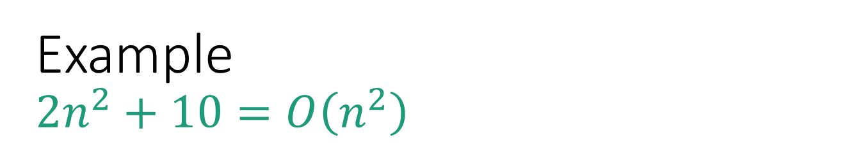
Example $$2n^{2}+10=O\left(n^{2}\right)$$
$$T\left(n\right)=O\left(g\left(n\right)\right)$$
$$⟺$$
$$∃c, n_{0}>0 s.t. ∀n≥n_{0},$$
$$0≤T\left(n\right)≤c⋅g(n)$$
T(n) = 2n² + 10
g(n) = n²

Slide 66
Example $$2n^{2}+10=O\left(n^{2}\right)$$
$$T\left(n\right)=O\left(g\left(n\right)\right)$$
$$⟺$$
$$∃c, n_{0}>0 s.t. ∀n≥n_{0},$$
$$0≤T\left(n\right)≤c⋅g(n)$$
3g(n) = 3n²
T(n) = 2n² + 10
g(n) = n²

Slide 67
Example $$2n^{2}+10=O\left(n^{2}\right)$$
$$T\left(n\right)=O\left(g\left(n\right)\right)$$
$$⟺$$
$$∃c, n_{0}>0 s.t. ∀n≥n_{0},$$
$$0≤T\left(n\right)≤c⋅g(n)$$
n₀=4
3g(n) = 3n²
T(n) = 2n² + 10
g(n) = n²

Slide 68
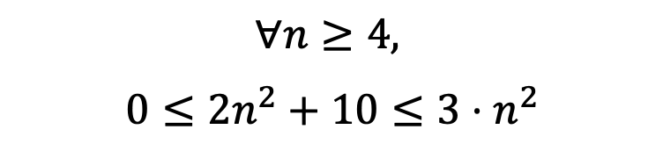
Example $$2n^{2}+10=O\left(n^{2}\right)$$
$$T\left(n\right)=O\left(g\left(n\right)\right)$$
$$⟺$$
$$∃c, n_{0}>0 s.t. ∀n≥n_{0},$$
$$0≤T\left(n\right)≤c⋅g(n)$$
n₀=4
Formally:
Choose c = 3
Choose n₀ = 4
Then:
3g(n) = 3n²
T(n) = 2n² + 10
$$∀n≥4,$$
$$0≤2n^{2}+10≤3⋅n^{2}$$
g(n) = n²

Slide 69
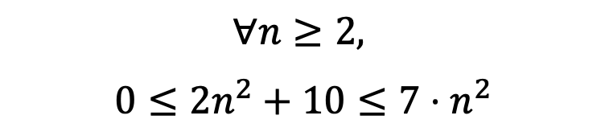
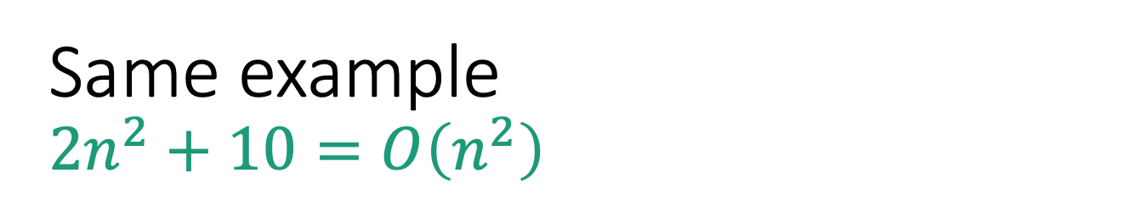
Same example $$2n^{2}+10=O\left(n^{2}\right)$$
$$T\left(n\right)=O\left(g\left(n\right)\right)$$
$$⟺$$
$$∃c, n_{0}>0 s.t. ∀n≥n_{0},$$
$$0≤T\left(n\right)≤c⋅g(n)$$
Formally:
Choose c = 7
Choose n₀ = 2
Then:
7g(n) = 7n²
T(n) = 2n² + 10
$$∀n≥2,$$
$$0≤2n^{2}+10≤7⋅n^{2}$$
g(n) = n²
There is not a “correct” choice of c and n₀
n₀=2

Slide 70
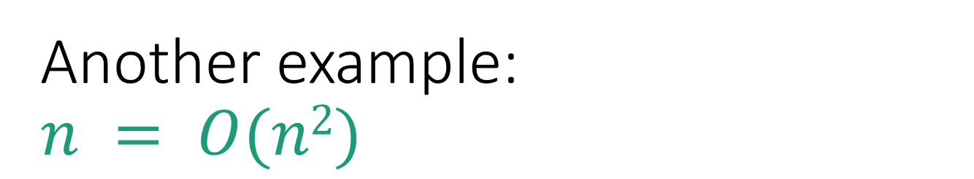

Another example: $$n = O(n2)$$
$$T\left(n\right)=O\left(g\left(n\right)\right)$$
$$⟺$$
$$∃c, n_{0}>0 s.t. ∀n≥n_{0},$$
$$0≤T\left(n\right)≤c⋅g(n)$$
g(n) = n²
Choose c = 1
Choose n₀ = 1
Then
$$∀n≥1,$$
$$0≤n≤n^{2}$$
T(n) = n

Slide 71
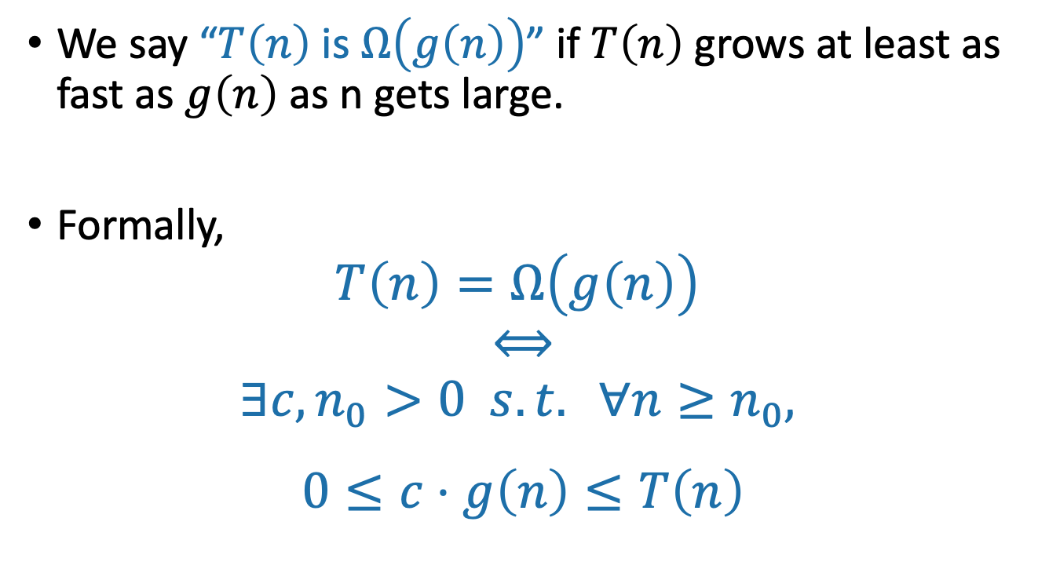
Ω(…) means a lower bound
We say “$T\left(n\right)$ is $Ω\left(g\left(n\right)\right)$” if $T\left(n\right)$ grows at least as fast as $g\left(n\right)$ as n gets large.
Formally,
$$T\left(n\right)=Ω\left(g\left(n\right)\right)$$
$$⟺$$
$$∃c, n_{0}>0 s.t. ∀n≥n_{0},$$
$$0≤c⋅g\left(n\right)≤T\left(n\right)$$
Switched these!!

Slide 72
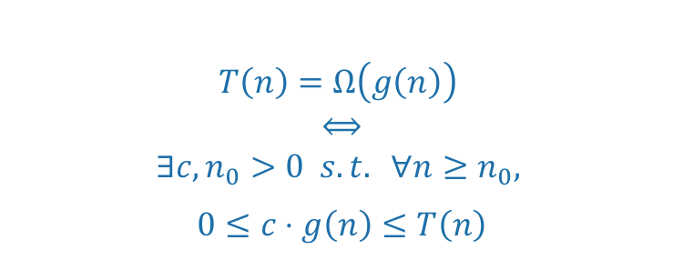
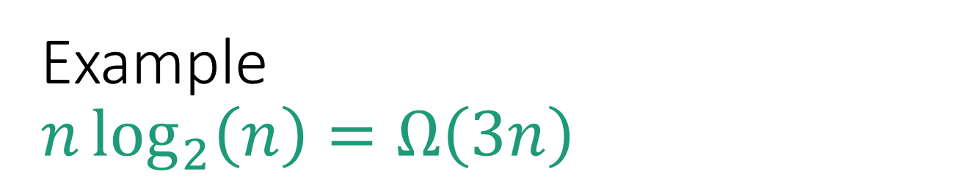
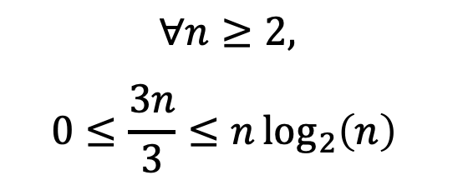
Example $$n\log_{2}\left(n\right)=Ω\left(3n\right)$$
$$T\left(n\right)=Ω\left(g\left(n\right)\right)$$
$$⟺$$
$$∃c, n_{0}>0 s.t. ∀n≥n_{0},$$
$$0≤c⋅g\left(n\right)≤T\left(n\right)$$
g(n) = 3n
Choose c = 1/3
Choose n₀ = 2
Then
T(n) = nlog(n)
$$∀n≥2,$$
$$0≤\frac{3n}{3}≤n\log_{2}\left(n\right)⁡$$
g(n)/3 = n

Slide 73
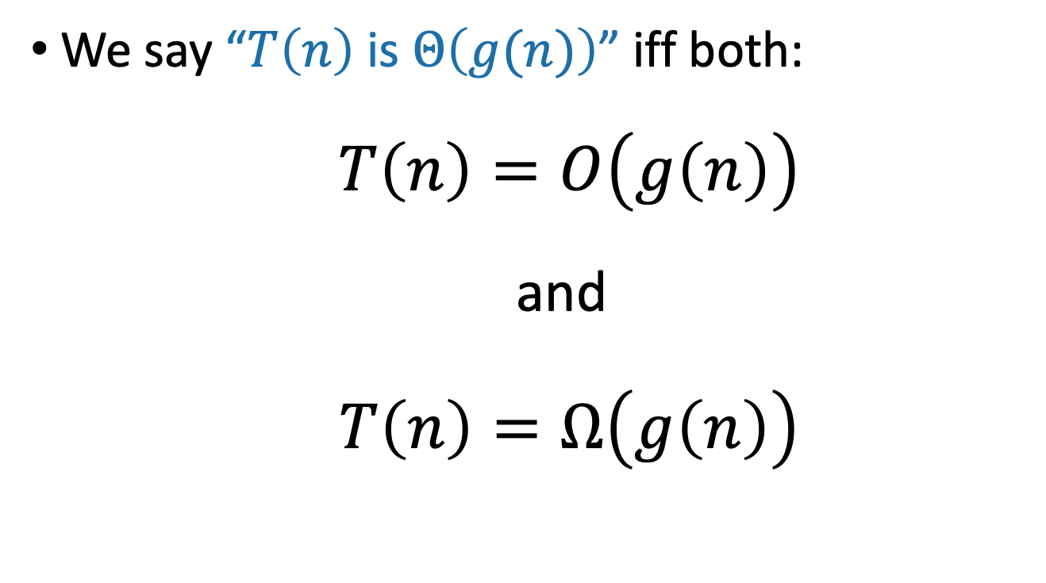
Θ(…) means both!
We say “$T\left(n\right)$ is $Θ\left(g(n)\right)$” iff both:
$T\left(n\right)=O\left(g\left(n\right)\right)$
and
$T\left(n\right)=Ω\left(g\left(n\right)\right)$

Slide 74
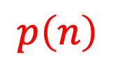
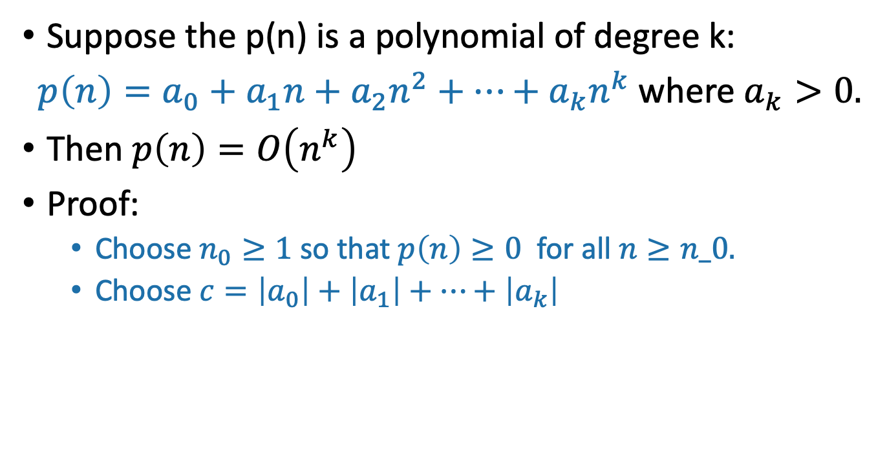
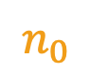
Example: polynomials
Suppose the p(n) is a polynomial of degree k:
$p\left(n\right)=a_{0}+a_{1}n+a_{2}n^{2}+⋯+a_{k}n^{k}$ where $a_{k}>0.$
Then $p\left(n\right)=O\left(n^{k}\right)$
Proof:
Choose $n_{0}≥1$ so that $p\left(n\right)≥0$ for all $n≥n_0.$
Choose $c=\left|a_{0}\right|+\left|a_{1}\right|+⋯+\left|a_{k}\right|$
$$p\left(n\right)$$
$$n_{0}$$

Slide 75
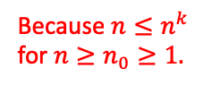
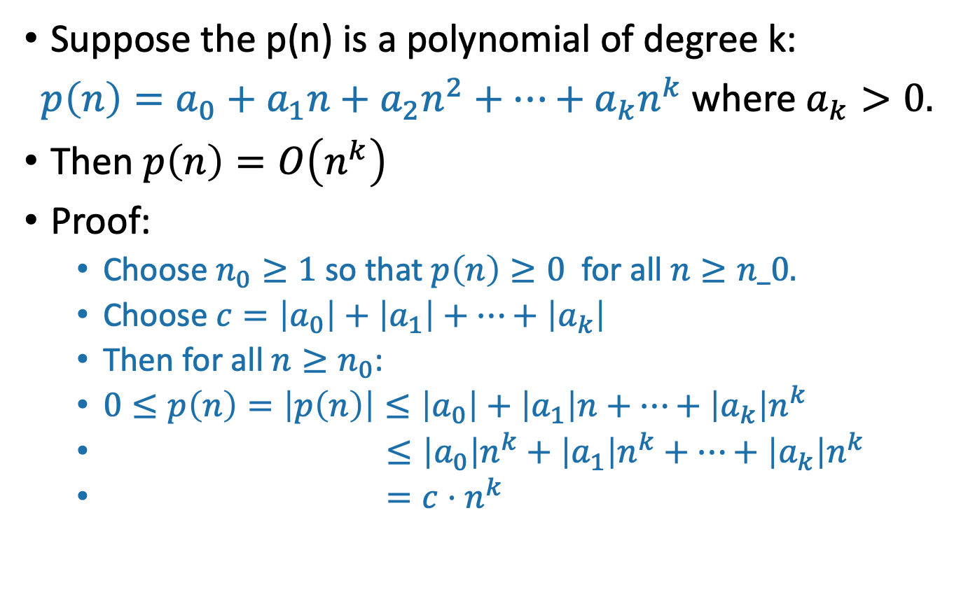
Example: polynomials
Suppose the p(n) is a polynomial of degree k:
$p\left(n\right)=a_{0}+a_{1}n+a_{2}n^{2}+⋯+a_{k}n^{k}$ where $a_{k}>0.$
Then $p\left(n\right)=O\left(n^{k}\right)$
Proof:
Choose $n_{0}≥1$ so that $p\left(n\right)≥0$ for all $n≥n_0.$
Choose $c=\left|a_{0}\right|+\left|a_{1}\right|+⋯+\left|a_{k}\right|$
Then for all $n≥n_{0}$:
$0≤p\left(n\right)=\left|p\left(n\right)\right|≤\left|a_{0}\right|+\left|a_{1}\right|n+⋯+\left|a_{k}\right|n^{k}$
$≤\left|a_{0}\right|n^{k}+\left|a_{1}\right|n^{k}+⋯+\left|a_{k}\right|n^{k}$
$=c⋅n^{k}$
Triangle inequality!
Because $n≤n^{k}$ for $n≥n_{0}≥1.$
Definition of c

Slide 76
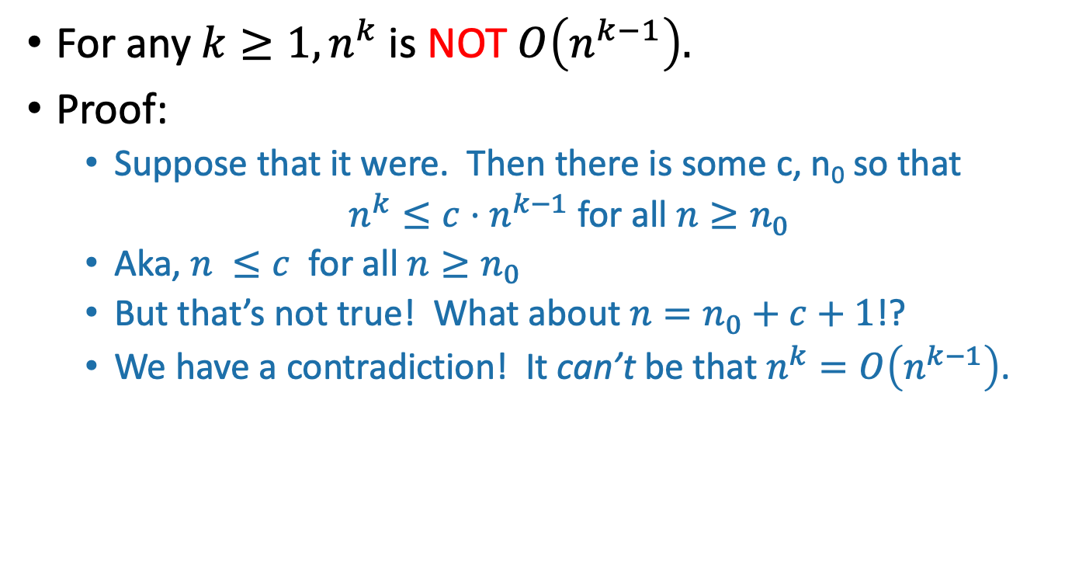
Example: more polynomials
For any $k≥1, n^{k}$ is NOT $O\left(n^{k−1}\right).$
Proof:
Suppose that it were. Then there is some c, n₀ so that
$n^{k}≤c⋅n^{k−1}$ for all $n≥n_{0}$
Aka, $n^{ }≤c$ for all $n≥n_{0}$
But that’s not true! What about $n=n_{0}+c+1$!?
We have a contradiction! It can’t be that $n^{k}=O\left(n^{k−1}\right)$.

Slide 77
Take-away from examples
To prove T(n) = O(g(n)), you have to come up with c and n₀ so that the definition is satisfied.
To prove T(n) is NOT O(g(n)), one way is proof by contradiction:
Suppose (to get a contradiction) that someone gives you a c and an n₀ so that the definition is satisfied.
Show that this someone must by lying to you by deriving a contradiction.

Slide 78
Yet more examples
n³ + 3n = O(n³ – n²)
n³ + 3n = Ω(n³ – n²)
n³ + 3n = Θ(n³ – n²)
3^{n} is NOT O(2^{n})
log(n) = Ω(ln(n))
log(n) = Θ( 2^{loglog(n)} )
Work through these on your own!
Siggi the Studious Stork
remember that log = log₂ in this class.

Slide 79
Some brainteasers
Are there functions f, g so that NEITHER f = O(g) nor f = Ω(g)?
Are there non-decreasing functions f, g so that the above is true?
Define the n’th fibonacci number by F(0) = 1, F(1) = 1, F(n) = F(n-1) + F(n-2) for n > 2.
1, 1, 2, 3, 5, 8, 13, 21, 34, 55, …
True or false:
F(n) = O(2^{n})
F(n) = Ω(2^{n})
Ollie the Over-achieving Ostrich

Slide 80
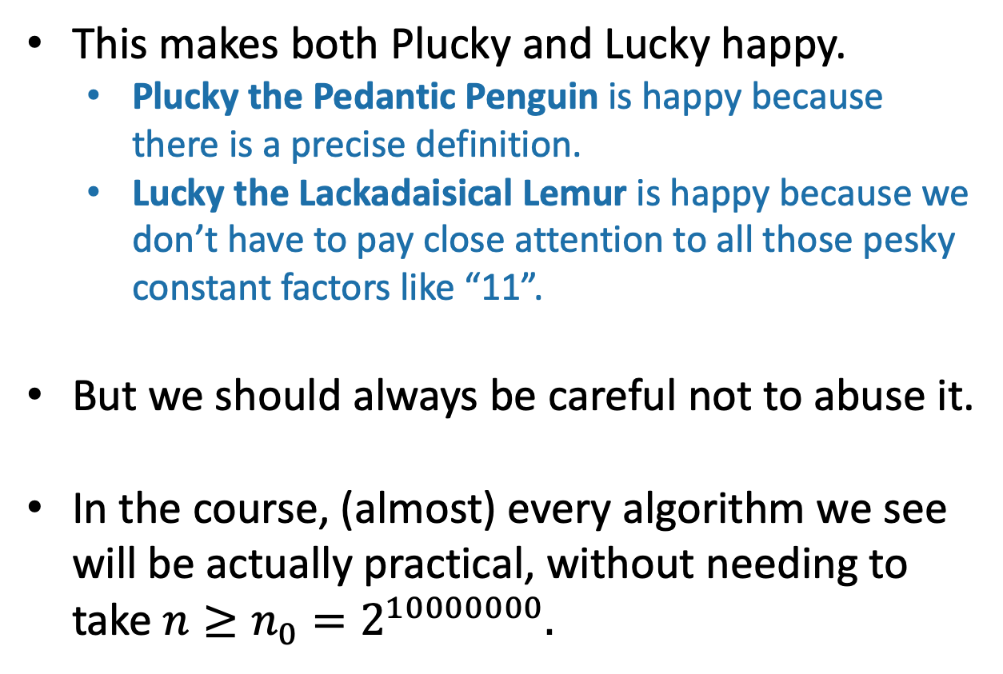
Recap: Asymptotic Notation
This is my happy face!
This makes both Plucky and Lucky happy.
Plucky the Pedantic Penguin is happy because there is a precise definition.
Lucky the Lackadaisical Lemur is happy because we don’t have to pay close attention to all those pesky constant factors like “11”.
But we should always be careful not to abuse it.
In the course, (almost) every algorithm we see will be actually practical, without needing to take $n≥n_{0}=2^{10000000}.$

Slide 81
The plan
Part I: Sorting Algorithms
InsertionSort: does it work and is it fast?
MergeSort: does it work and is it fast?
Skills:
Analyzing correctness of iterative and recursive algorithms.
Analyzing running time of recursive algorithms (part A)
Part II: How do we measure the runtime of an algorithm?
Worst-case analysis
Asymptotic Analysis
Wrap-Up

Slide 82
Recap
InsertionSort runs in time O(n²)
MergeSort is a divide-and-conquer algorithm that runs in time O(n log(n))
How do we show an algorithm is correct?
Today, we did it by induction
How do we measure the runtime of an algorithm?
Worst-case analysis
Asymptotic analysis

Slide 83
Next time
A more systematic approach to analyzing the runtime of recursive algorithms.
Before next time
Pre-Lecture Exercise:
A few recurrence relations (see website)

